Slide 1
Flooded Road Monitoring System Using IoT and Cloud
Hemalatha Chaganti
X24242560

Slide 2
Problem Statement
Flooded roads are dangerous because people cannot easily understand the current situation. There is no real-time system to monitor water levels and road conditions. This project aims to solve this problem using IoT and cloud technologies.

Slide 3
Solution Overview
Use IoT sensors to collect data
Process data using fog computing
Send data to cloud using MQTT
Store data in AWS DynamoDB
Display results using a web dashboard

Slide 4
How Sensors Work
Sensors continuously generate data for different roads.
Each sensor provides values like water level and rainfall, temperature, humidity.
In this project, the data is simulated but behaves like real sensors.

Slide 5
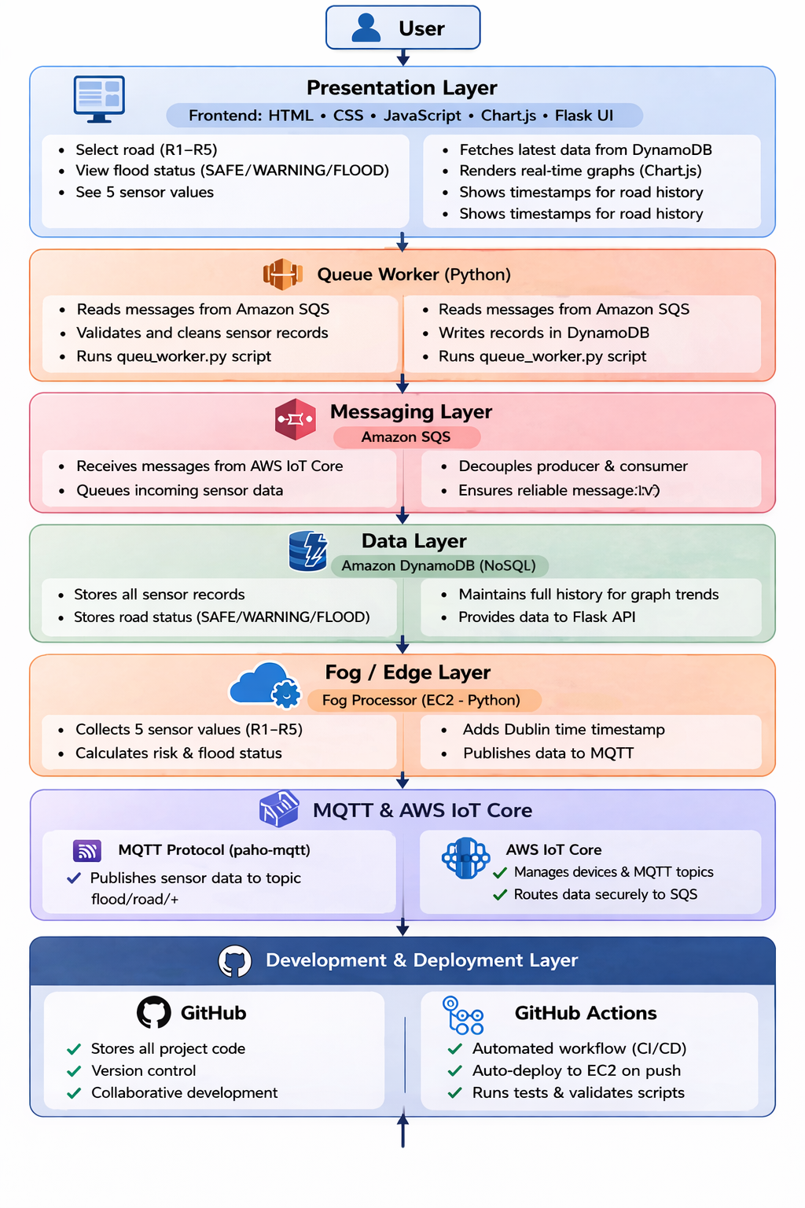
Architecture Flow
Fog processor processes sensor data
MQTT sends data to AWS IoT Core
IoT Core forwards data to SQS
Queue Worker reads data from SQS
Data is stored in DynamoDB
Dashboard reads data and displays it

Slide 6
How Graphs Work
Data is stored in DynamoDB (history table)
Each record has:
road_id
timestamp
sensor values
Flask app fetches multiple records
Graphs are created using Chart.js
Graphs show trends over time

Slide 7
Conclusion
This project successfully shows how IoT and cloud technologies can be used to monitor flooded roads.
The system provides real-time data and graphs, which makes it easier to understand road conditions.
Future improvements can make the system more advanced.

